Slide 1
Decisions decisions decisions
#3

Slide 2
Logic
Or is it?

Slide 3
Booleans again
Boolean represent truthiness of statements
boolean condition = false;
condition = true;
Booleans can store the result of comparisons
int x=-2, y=10;
boolean isXgreaterThanY = x>y; // false
boolean isXNegative = x<0; // true

Slide 4
Decisions
Beyond the simple calculator

Slide 5
So far….
Code runs sequentially
This only takes us so far ☹
int age = 33; System.out.print("Hello, what's your name? "); String name = keyboard.next(); System.out.print("How old are you " + name + "?"); age = keyboard.nextInt();

Slide 6
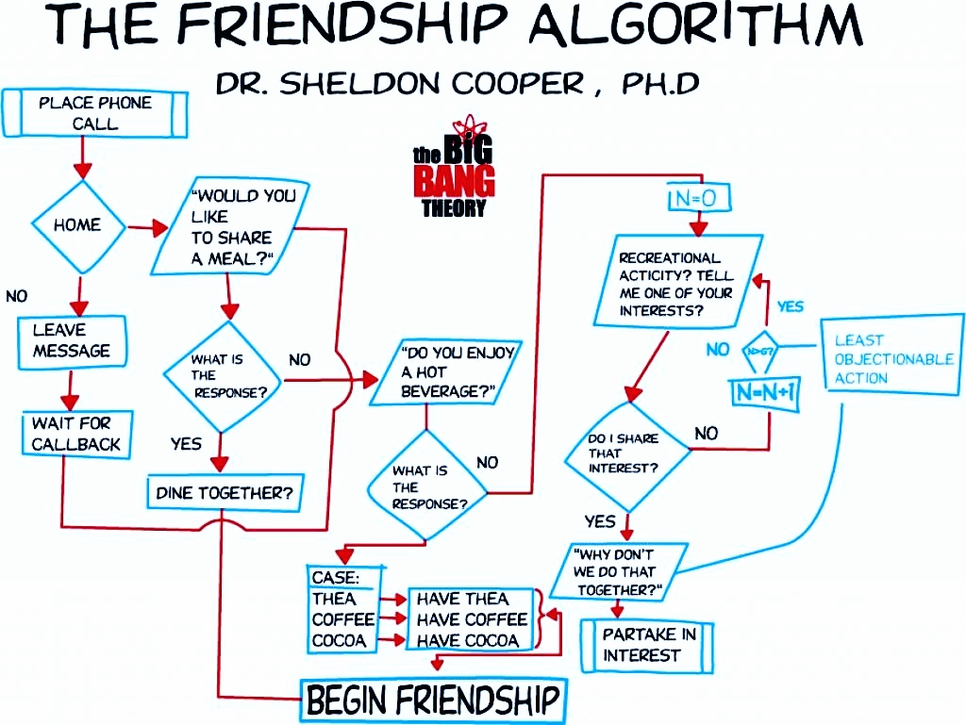
Algorithms with choices

Slide 7
Making decisions
If statements
A structure that allows us to make decisions!
boolean isHome = true; if(isHome) { System.out.println(“Share a meal?"); } System.out.println("This always runs!");

Slide 8
Making different decisions
Else allows us to do something else (ah!) when the condition is false
boolean isHome = true; if(isHome) { System.out.println("Share a meal?"); } else { System.out.println(“Leave a message!"); } System.out.println("This always runs!");

Slide 9
Multiple choices
boolean enjoyHotBeverage = true;
boolean enjoyActivities = true; if( enjoyHotBeverage ) { System.out.println(“Which beverage?"); System.out.println(“Don’t know if likes activities!"); } else if( enjoyHotBeverage ) { System.out.println(“Doesn’t like hot beverages!");
System.out.println(“But likes activities!"); } else { System.out.println(“No beverages, no activities!"); } System.out.println("This always runs!");

Slide 10
Don’t use the else without the if
Don’t do this!
boolean funny = false; if(funny) { } else { System.out.println(“Not funny :("); } System.out.println("This always runs!");

Slide 11
This is funny…. NOT!
If you need to negate a condition, you have the NOT operator
funny | NOT funny
Yes | No
No | Yes
funny | !funny
true | false
false | true
boolean funny = true; boolean notFunny = !funny;

Slide 12
Negate the condition
If you negate the condition, you can remove the empty if statement
boolean funny = false; if(!funny) { System.out.println(“Not funny :("); } System.out.println("This always runs!");

Slide 13
Advanced conditions
Ready OR Set AND Go!

Slide 14
AND and OR – Going to the beach
Can I go with my car?
Can I go using public transportation?
Car | Fuel | Going to the beach
No | No | No
No | Yes | No
Yes | No | No
Yes | Yes | Yes
Bus | Train | Going to the beach
No | No | No
No | Yes | Yes
Yes | No | Yes
Yes | Yes | Yes
To go to the beach I need both: Car AND Fuel
To go to the beach I need either: Bus OR Train
A | B | Result
False | False | False
False | True | False
True | False | False
True | True | True
A | B | Result
False | False | False
False | True | True
True | False | True
True | True | True

Slide 15
Going to the beach with Java
Can I go with my car?
Can I go using public transportation?
boolean haveCar, haveFuel; if ( haveCar && haveFuel ){ System.out.println("Can go to the beach!"); }
boolean haveBus, haveTrain; if ( haveBus || haveTrain ){ System.out.println("Can go to the beach!"); }

Slide 16
Short-circuits
Short-circuit: decide before evaluating everything
E.g. if I have a bus that I can take it doesn’t matter if I have a train
E.g. if I have a car and fuel, doesn’t matter if I have a bus or a train
Boolean haveBus, haveTrain; if ( haveBus || haveTrain )
{ System.out.println("Can go to the beach!"); }
boolean haveCar, haveFuel, haveBus, haveTrain; if ( (haveCar && haveFuel) || haveBus || haveTrain )
{ System.out.println("Can go to the beach!"); }

Slide 17
Order again
So… () go first, */% go second, and +- go third
Where do the boolean operators fit in this?
So what goes before/after that?
NOT goes before
Relational operators go after
Logical operators go last
Last thing done is always assignment
Operator | Associativity
-(negation) ! (NOT) | Right to left
* / % | Left to right
+ - | Left to right
< > <= >= | Left to right
== != | Left to right
&& | Left to right
|| | Left to right
= += -= *= /= %= | Right to left

Slide 18
Soooooo…..
Some thing like this
age > 30 && height < 70
Is equivalent to this
(age > 30) && (height < 70)
But the second one is WAYYYY more clear ☺
So use parentheses
Clarity over character economy!!!

Slide 19
Switches get stitches
Or something like that

Slide 20
When all conditions are equal
This is possible! And there is nothing wrong with it.
However…
String beverage = “Tea".toLowerCase(); if (beverage.equals(“tea"))
{ System.out.println(“Serve some tea"); }
else if (beverage.equals(“coffee"))
{ System.out.println(“Serve some coffee"); }
else if (beverage.equals(“cocoa"))
{ System.out.println(“Serve some cocoa"); }
else
{ System.out.println(“I don’t have that ☹"); }

Slide 21
Switches
There is another Java decision structure that you can use
String beverage = “Tea".toLowerCase();
switch (beverage) { case "tea": System.out.println("Serve some tea"); break; case "coffee": System.out.println("Serve some coffee"); break; case "cocoa": System.out.println("Serve some cocoa"); break; default: System.out.println("I don’t have that ☹"); break; }
These are needed to leave the switch

Slide 22
Switches
If you remove the breaks, you have the grandmother switch
“You are not eating properly, have everything!”
String beverage = “Tea".toLowerCase();
switch (beverage) { case "tea": System.out.println("Serve some tea"); //break; case "coffee": System.out.println("Serve some coffee"); //break; case "cocoa": System.out.println("Serve some cocoa"); //break; default: System.out.println("I don’t have that ☹ "); //break; }
Remove them. See what happens

Slide 23
Switches
Switches only work with some types:
Integer types (byte, short, int, long)
String
char
The case must be a literal!
No variables
If that is needed use ifs
No comparisons
Either equal or not-equal
No greater/less than, etc.
default is the default behaviour (i.e. if nothing else matches)
String beverage = “Tea".toLowerCase();
switch (beverage) { case <literal>: // Runs if break; case <literal>: System.out.println("Serve some coffee"); break; default: System.out.println("I don’t have that ☹"); break; }

Slide 24
Scopes
Can you see them?

Slide 25
Blocks and scopes
Blocks start with { and end with } – each defines its own scope
They can be stacked
Parent scopes are visible in children scopes
Sibling scopes are not visible to each other
Variables with same name cannot exist in children scopes
Variables with same name can exist in sibling scopes
public class Main { public static void main( String []args) { // Main scope int value = 10; if(true) { // If scope double value; // Illegal because a parent scope already has the variable String valueString = "Value: "; // value can be used because it's a parent scope! System.out.println(valueString + value); // value can be modified! value = 2; } else { // else scope // This is fine, because the if scope is a sibling! String valueString = "Value: "; // value can be used because it's a parent scope! System.out.println(valueString + value); // value can be modified! value = 4; } // Only from this point onwards valueString also exists in the main scope String valueString = "Value: "; System.out.println(valueString + value); } }

